Slide 1


Big Data Infrastructure
CS 489/698 Big Data Infrastructure (Winter 2016)
Week 5: Analyzing Graphs (2/2)
February 4, 2016
Jimmy Lin
David R. Cheriton School of Computer Science
University of Waterloo
These slides are available at http://lintool.github.io/bigdata-2016w/
This work is licensed under a Creative Commons Attribution-Noncommercial-Share Alike 3.0 United States See http://creativecommons.org/licenses/by-nc-sa/3.0/us/ for details

Slide 2

Single Source Shortest Path
Source: Wikipedia (Wave)

Slide 3
Visualizing Parallel BFS
n₇
n₀
n₁
n₃
n₂
n₆
n₅
n₄
n₈
n₉

Slide 4
From Intuition to Algorithm
Data representation:
Key: node n
Value: d (distance from start), adjacency list (nodes reachable from n)
Initialization: for all nodes except for start node, d = ∞
Mapper:
∀m ∈ adjacency list: emit (m, d + 1)
Remember to also emit distance to yourself
Sort/Shuffle
Groups distances by reachable nodes
Reducer:
Selects minimum distance path for each reachable node
Additional bookkeeping needed to keep track of actual path

Slide 5
Multiple Iterations Needed
Each MapReduce iteration advances the “frontier” by one hop
Subsequent iterations include more and more reachable nodes as frontier expands
Multiple iterations are needed to explore entire graph
Preserving graph structure:
Problem: Where did the adjacency list go?
Solution: mapper emits (n, adjacency list) as well
Ugh! This is ugly!

Slide 6
Implementation Practicalities
HDFS
map
reduce
Convergence?
HDFS

Slide 7

Application: Social Search
Source: Wikipedia (Crowd)

Slide 8
Social Search
When searching, how to rank friends named “John”?
Assume undirected graphs
Rank matches by distance to user
Naïve implementations:
Precompute all-pairs distances
Compute distances at query time
Can we do better?

Slide 9
All-Pairs?
Floyd-Warshall Algorithm: difficult to MapReduce-ify…
Multiple-source shortest paths in MapReduce: run multiple parallel BFS simultaneously
Assume source nodes {s₀, s₁, … s_{n}}
Instead of emitting a single distance, emit an array of distances, with respect to each source
Reducer selects minimum for each element in array
Does this scale?

Slide 10
Landmark Approach (aka sketches)
Select n seeds {s₀, s₁, … s_{n}}
Compute distances from seeds to every node:
What can we conclude about distances?
Insight: landmarks bound the maximum path length
Lots of details:
How to more tightly bound distances
How to select landmarks (random isn’t the best…)
Use multi-source parallel BFS implementation in MapReduce!
A = [2, 1, 1]
B = [1, 1, 2]
C = [4, 3, 1]
D = [1, 2, 4]
Nodes
Distances to seeds

Slide 11
Graphs and MapReduce
A large class of graph algorithms involve:
Performing computations at each node: based on node features, edge features, and local link structure
Propagating computations: “traversing” the graph
Generic recipe:
Represent graphs as adjacency lists
Perform local computations in mapper
Pass along partial results via outlinks, keyed by destination node
Perform aggregation in reducer on inlinks to a node
Iterate until convergence: controlled by external “driver”
Don’t forget to pass the graph structure between iterations

Slide 12

PageRank
(The original “secret sauce” for evaluating the importance of web pages)
(What’s the “Page” in PageRank?)

Slide 13
Random Walks Over the Web
Random surfer model:
User starts at a random Web page
User randomly clicks on links, surfing from page to page
PageRank
Characterizes the amount of time spent on any given page
Mathematically, a probability distribution over pages
PageRank captures notions of page importance
Correspondence to human intuition?
One of thousands of features used in web search

Slide 14
PageRank: Defined
Given page x with inlinks t₁…t_{n}, where
C(t) is the out-degree of t
α is probability of random jump
N is the total number of nodes in the graph
t₁
X
t₂
…
t_{n}

Slide 15
Computing PageRank
Properties of PageRank
Can be computed iteratively
Effects at each iteration are local
Sketch of algorithm:
Start with seed PR_{i} values
Each page distributes PR_{i} “credit” to all pages it links to
Each target page adds up “credit” from multiple in-bound links to compute PR_{i+1}
Iterate until values converge

Slide 16
Simplified PageRank
First, tackle the simple case:
No random jump factor
No dangling nodes
Then, factor in these complexities…
Why do we need the random jump?
Where do dangling nodes come from?

Slide 17
Sample PageRank Iteration (1)
Iteration 1
n₂ (0.2)
n₂ (0.166)
n₁ (0.2)
0.1
0.1
0.1
n₁ (0.066)
0.1
0.066
0.066
0.066
n₅ (0.2)
n₃ (0.2)
n₅ (0.3)
n₃ (0.166)
0.2
0.2
n₄ (0.2)
n₄ (0.3)

Slide 18
Sample PageRank Iteration (2)
Iteration 2
n₂ (0.166)
n₂ (0.133)
n₁ (0.066)
0.033
0.083
0.083
n₁ (0.1)
0.033
0.1
0.1
0.1
n₅ (0.3)
n₃ (0.166)
n₅ (0.383)
n₃ (0.183)
0.3
0.166
n₄ (0.3)
n₄ (0.2)

Slide 19
PageRank in MapReduce
n₁ [n₂, n₄]
n₂ [n₃, n₅]
n₃ [n₄]
n₄ [n₅]
n₅ [n₁, n₂, n₃]
Map
n₂
n₄
n₃
n₅
n₄
n₅
n₁
n₂
n₃
n₁
n₂
n₂
n₃
n₃
n₄
n₄
n₅
n₅
Reduce
n₁ [n₂, n₄]
n₂ [n₃, n₅]
n₃ [n₄]
n₄ [n₅]
n₅ [n₁, n₂, n₃]

Slide 20
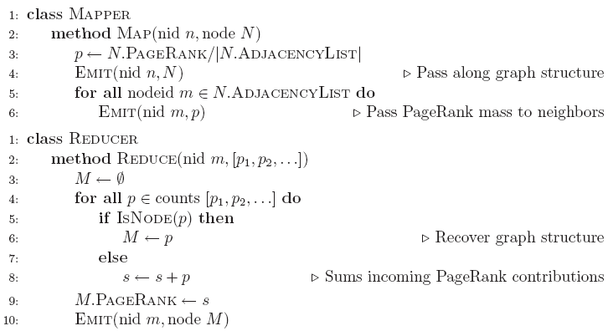
PageRank Pseudo-Code

Slide 21
PageRank vs. BFS
PageRank
BFS
Map
PR/N
d+1
Reduce
sum
min

Slide 22
Complete PageRank
Two additional complexities
What is the proper treatment of dangling nodes?
How do we factor in the random jump factor?
Solution:
Second pass to redistribute “missing PageRank mass” and account for random jumps
p is PageRank value from before, p' is updated PageRank value
N is the number of nodes in the graph
m is the missing PageRank mass
Additional optimization: make it a single pass!

Slide 23
Implementation Practicalities
HDFS
map
map
Convergence?
reduce
HDFS
HDFS
Ugh. Spark to the rescue?

Slide 24
PageRank Convergence
Alternative convergence criteria
Iterate until PageRank values don’t change
Iterate until PageRank rankings don’t change
Fixed number of iterations
Convergence for web graphs?
Not a straightforward question
Watch out for link spam and the perils of SEO:
Link farms
Spider traps
…

Slide 25
Beyond PageRank
Variations of PageRank
Weighted edges
Personalized PageRank
Variants on graph random walks
Hubs and authorities (HITS)
SALSA

Slide 26
Applications
Static prior for web ranking
Identification of “special nodes” in a network
Link recommendation
Additional feature in any machine learning problem

Slide 27
More Implementation Practicalities
How do you actually extract the webgraph?
Lots of details…

Slide 28


Source: http://www.flickr.com/photos/fusedforces/4324320625/

Slide 29
MapReduce Sucks
Java verbosity
Hadoop task startup time
Stragglers
Needless graph shuffling
Checkpointing at each iteration
Spark to the rescue?

Slide 30
Implementation Practicalities
HDFS
map
map
Convergence?
reduce
HDFS
HDFS

Slide 31
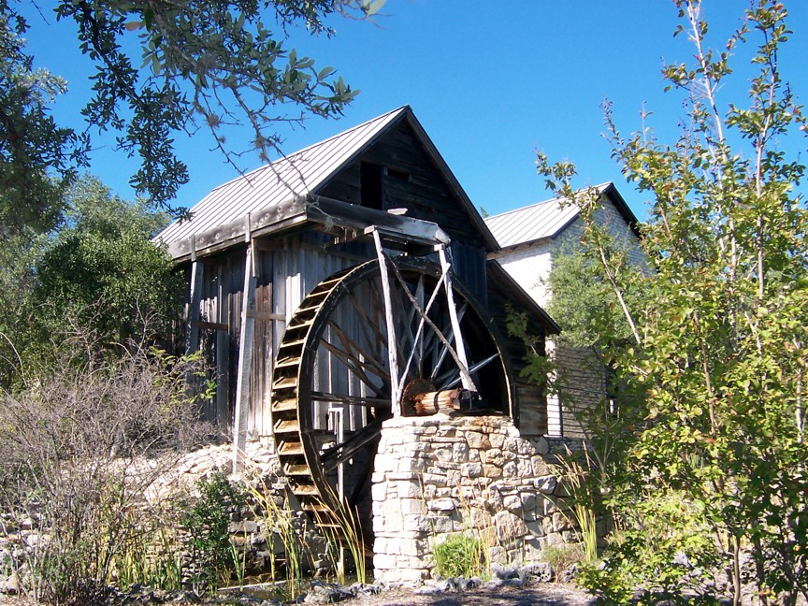
Iterative Algorithms
Source: Wikipedia (Water wheel)

Slide 32
In-Mapper Combining
Use combiners
Perform local aggregation on map output
Downside: intermediate data is still materialized
Better: in-mapper combining
Preserve state across multiple map calls, aggregate messages in buffer, emit buffer contents at end
Downside: requires memory management
buffer
setup
map
cleanup
Emit all key-value pairs at once

Slide 33
Better Partitioning
Default: hash partitioning
Randomly assign nodes to partitions
Observation: many graphs exhibit local structure
E.g., communities in social networks
Better partitioning creates more opportunities for local aggregation
Unfortunately, partitioning is hard!
Sometimes, chick-and-egg…
But cheap heuristics sometimes available
For webgraphs: range partition on domain-sorted URLs

Slide 34
Schimmy Design Pattern
Basic implementation contains two dataflows:
Messages (actual computations)
Graph structure (“bookkeeping”)
Schimmy: separate the two dataflows, shuffle only the messages
Basic idea: merge join between graph structure and messages
both relations sorted by join key
both relations consistently partitioned and sorted by join key
S
S₁
T
T₁
S₂
T₂
S₃
T₃

Slide 35
Do the Schimmy!
Schimmy = reduce side parallel merge join between graph structure and messages
Consistent partitioning between input and intermediate data
Mappers emit only messages (actual computation)
Reducers read graph structure directly from HDFS
from HDFS
(graph structure)
intermediate data
(messages)
from HDFS
(graph structure)
intermediate data
(messages)
from HDFS
(graph structure)
intermediate data
(messages)
S₁
T₁
S₂
T₂
S₃
T₃
Reducer
Reducer
Reducer

Slide 36
Experiments
Cluster setup:
10 workers, each 2 cores (3.2 GHz Xeon), 4GB RAM, 367 GB disk
Hadoop 0.20.0 on RHELS 5.3
Dataset:
First English segment of ClueWeb09 collection
50.2m web pages (1.53 TB uncompressed, 247 GB compressed)
Extracted webgraph: 1.4 billion links, 7.0 GB
Dataset arranged in crawl order
Setup:
Measured per-iteration running time (5 iterations)
100 partitions
From: Jimmy Lin and Michael Schatz. Design Patterns for Efficient Graph Algorithms in MapReduce. Proceedings of the Eighth Workshop on Mining and Learning with Graphs Workshop (MLG-2010)

Slide 37
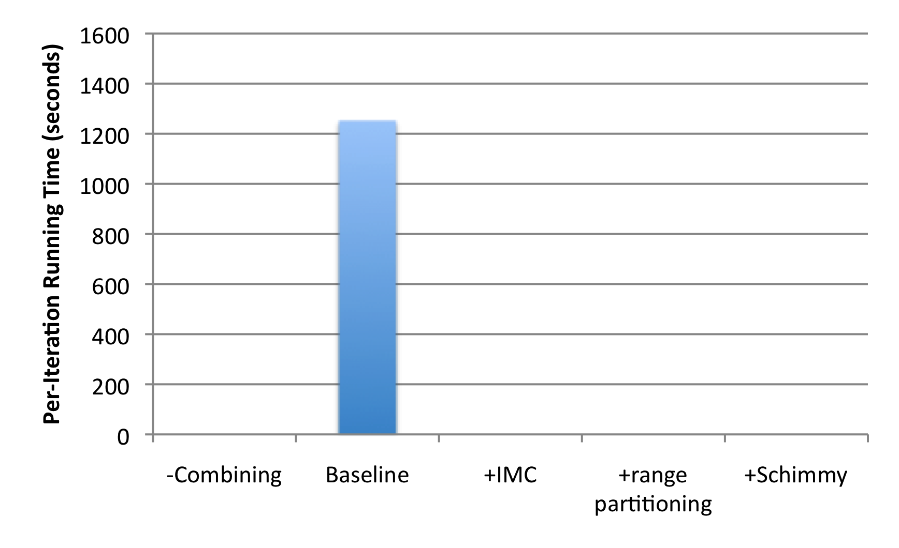
Results
“Best Practices”
From: Jimmy Lin and Michael Schatz. Design Patterns for Efficient Graph Algorithms in MapReduce. Proceedings of the Eighth Workshop on Mining and Learning with Graphs Workshop (MLG-2010)

Slide 38
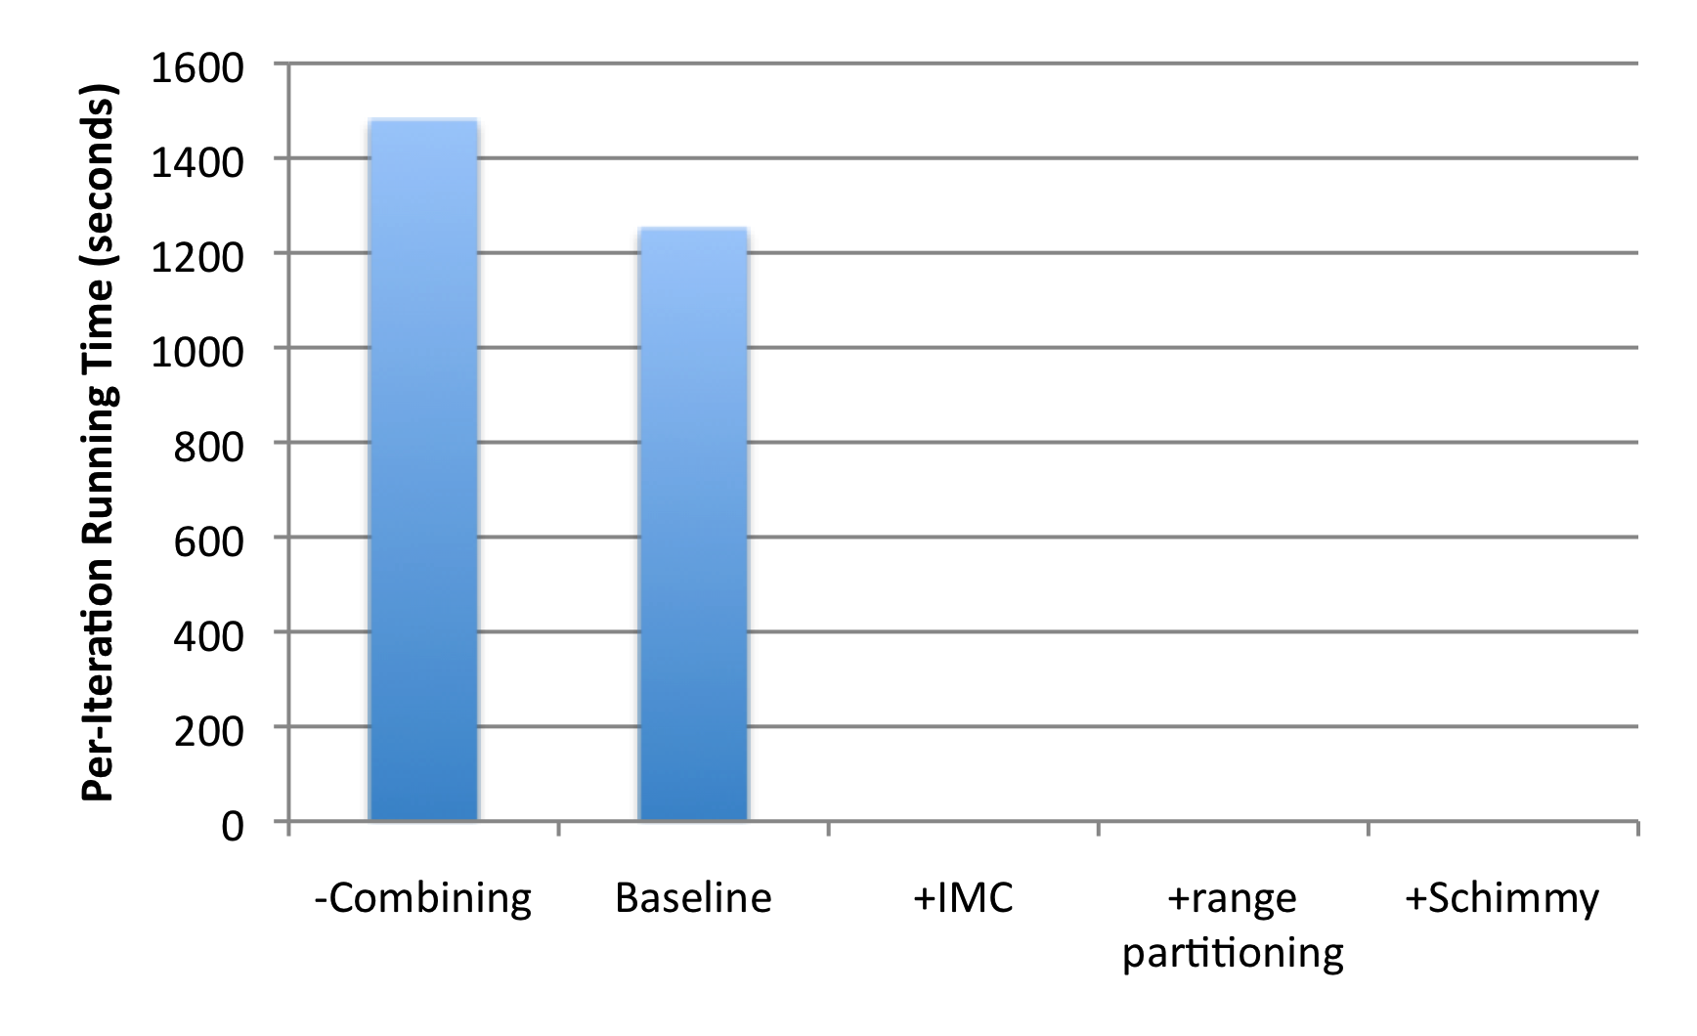
Results
+18%
1.4b
674m
From: Jimmy Lin and Michael Schatz. Design Patterns for Efficient Graph Algorithms in MapReduce. Proceedings of the Eighth Workshop on Mining and Learning with Graphs Workshop (MLG-2010)

Slide 39
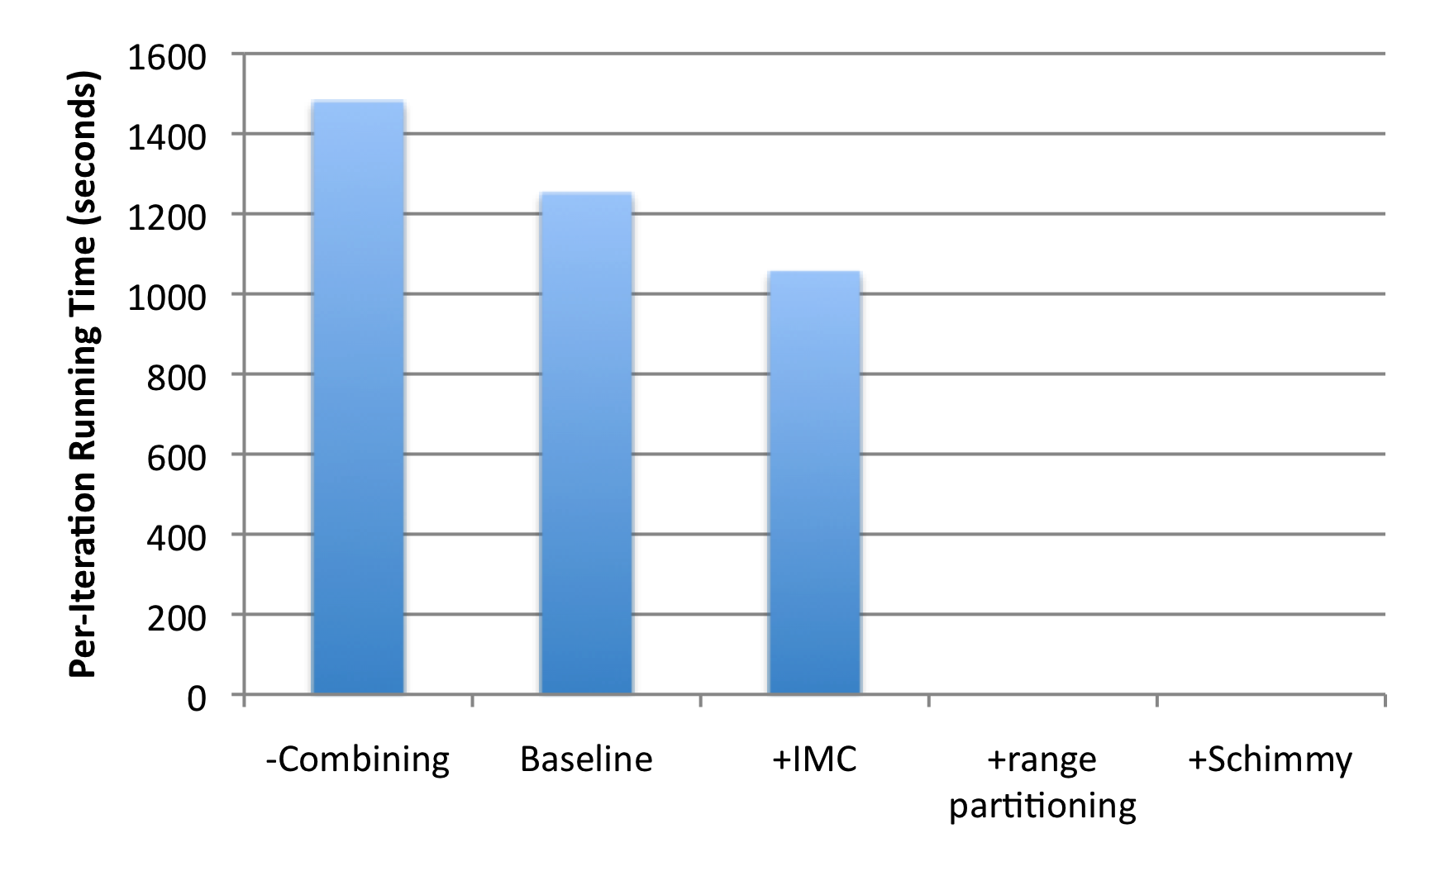
Results
+18%
1.4b
674m
-15%
From: Jimmy Lin and Michael Schatz. Design Patterns for Efficient Graph Algorithms in MapReduce. Proceedings of the Eighth Workshop on Mining and Learning with Graphs Workshop (MLG-2010)

Slide 40
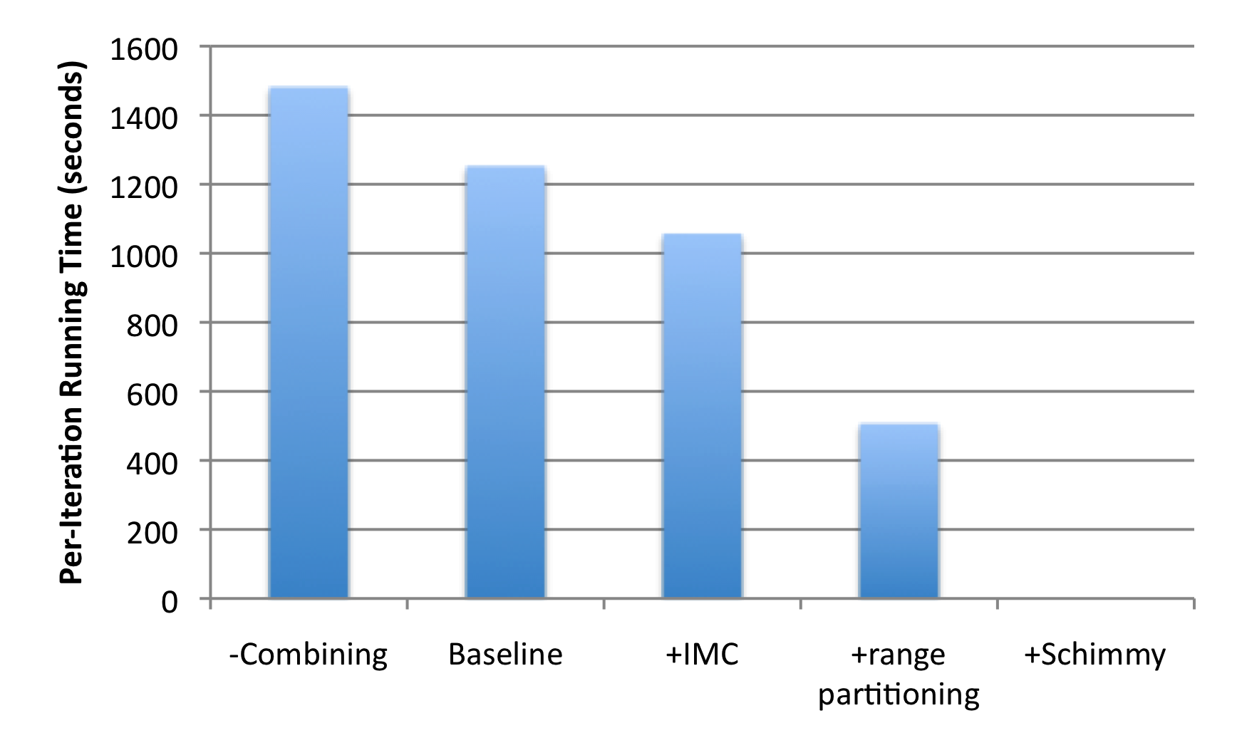
Results
+18%
1.4b
674m
-15%
-60%
86m
From: Jimmy Lin and Michael Schatz. Design Patterns for Efficient Graph Algorithms in MapReduce. Proceedings of the Eighth Workshop on Mining and Learning with Graphs Workshop (MLG-2010)

Slide 41
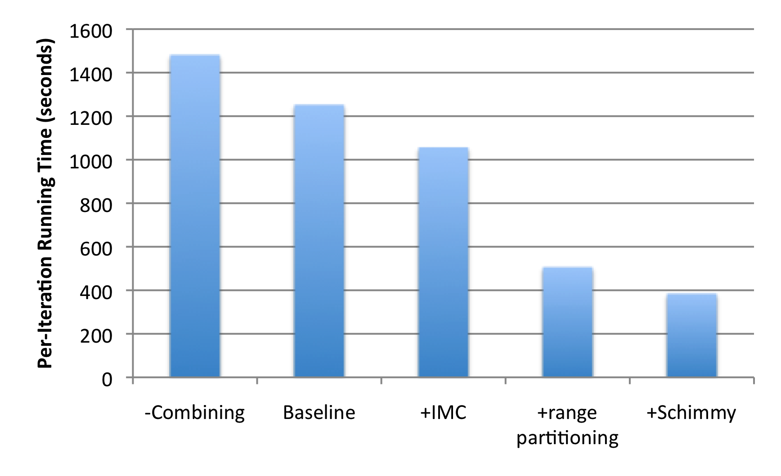
Results
+18%
1.4b
674m
-15%
-60%
86m
-69%
From: Jimmy Lin and Michael Schatz. Design Patterns for Efficient Graph Algorithms in MapReduce. Proceedings of the Eighth Workshop on Mining and Learning with Graphs Workshop (MLG-2010)

Slide 42
MapReduce Sucks
Java verbosity
Hadoop task startup time
Stragglers
Needless graph shuffling
Checkpointing at each iteration
What have we fixed?

Slide 43
Let’s Spark!
HDFS
map
reduce
HDFS
map
reduce
HDFS
map
reduce
HDFS
…
(omitting the second MapReduce job for simplicity; no handling of dangling links)

Slide 44
HDFS
map
reduce
map
reduce
map
reduce
…

Slide 45
HDFS
map
Adjacency Lists
PageRank Mass
reduce
map
Adjacency Lists
PageRank Mass
reduce
map
Adjacency Lists
PageRank Mass
reduce
…

Slide 46
HDFS
map
Adjacency Lists
PageRank Mass
join
map
Adjacency Lists
PageRank Mass
join
map
Adjacency Lists
PageRank Mass
join
…

Slide 47
HDFS
HDFS
Adjacency Lists
PageRank vector
join
flatMap
reduceByKey
PageRank vector
join
flatMap
reduceByKey
PageRank vector
join
…

Slide 48
HDFS
HDFS
Adjacency Lists
PageRank vector
Cache!
join
flatMap
reduceByKey
PageRank vector
join
flatMap
reduceByKey
PageRank vector
join
…

Slide 49
MapReduce vs. Spark
Source: http://ampcamp.berkeley.edu/wp-content/uploads/2012/06/matei-zaharia-part-2-amp-camp-2012-standalone-programs.pdf

Slide 50
Spark to the Rescue!
Java verbosity
Hadoop task startup time
Stragglers
Needless graph shuffling
Checkpointing at each iteration
What have we fixed?

Slide 51
HDFS
HDFS
Adjacency Lists
PageRank vector
Cache!
join
flatMap
reduceByKey
Still not particularly satisfying?
PageRank vector
join
flatMap
reduceByKey
PageRank vector
join
…

Slide 52

Stay Tuned!
Source: https://www.flickr.com/photos/smuzz/4350039327/

Slide 53

Questions?
Remember: Assignment 4 due next Tuesday at 8:30am
Source: Wikipedia (Japanese rock garden)

